Slide 1
Final Project
Chenxi Xu

Slide 2
Continue with my midterm…

Slide 3
DEMO

Slide 4
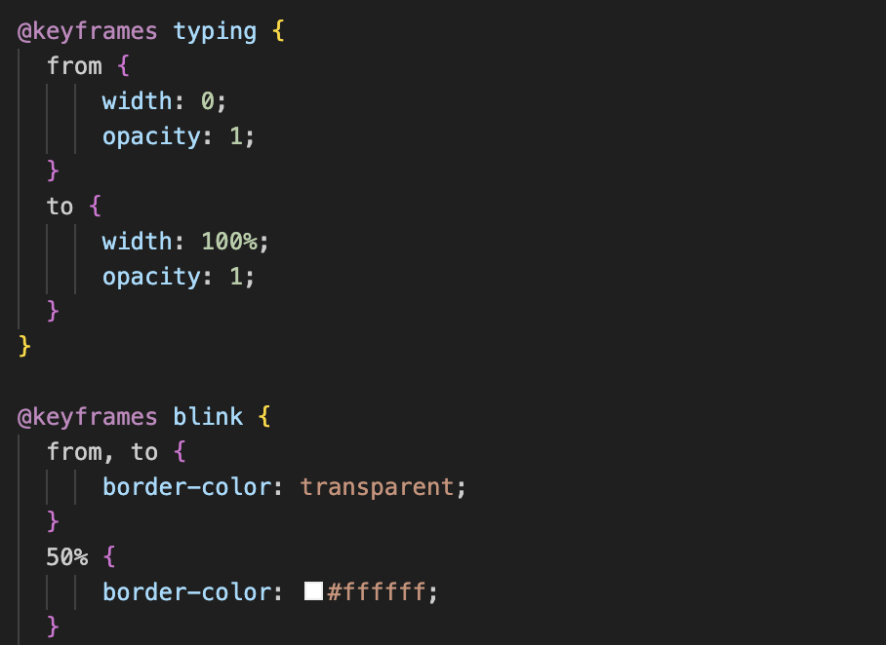
Typing effect

Slide 5
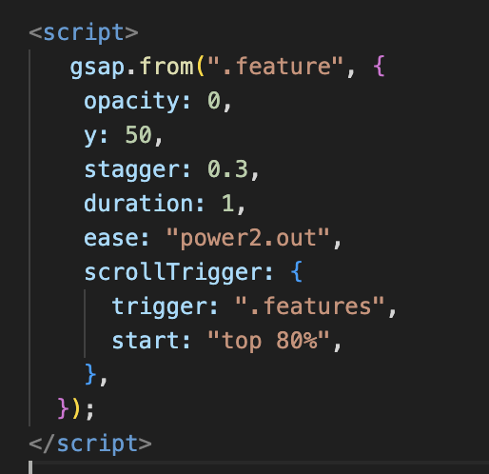
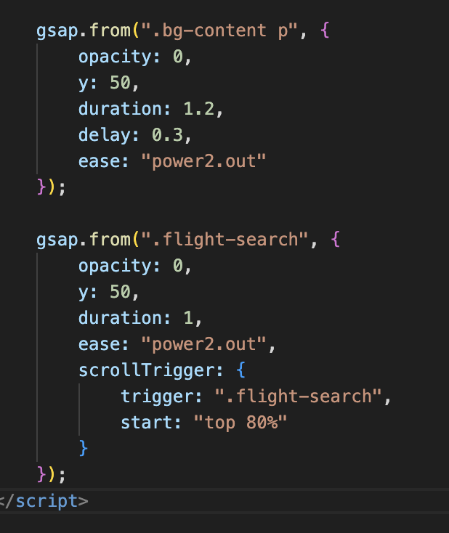
Gsap

Slide 6
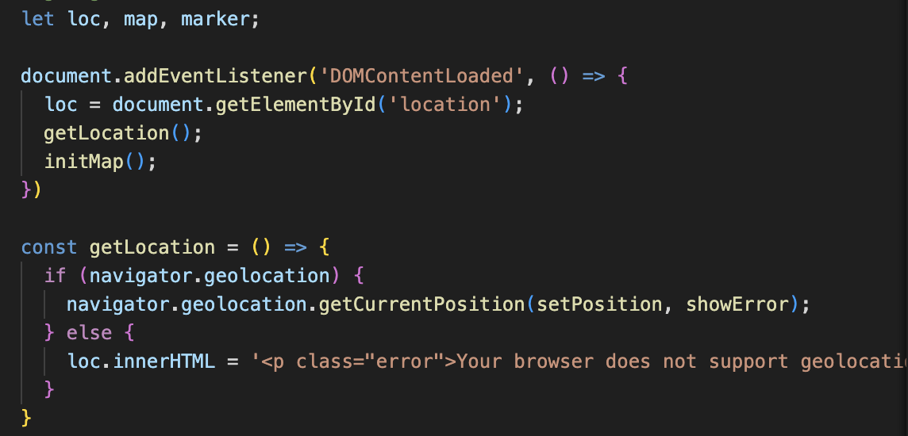
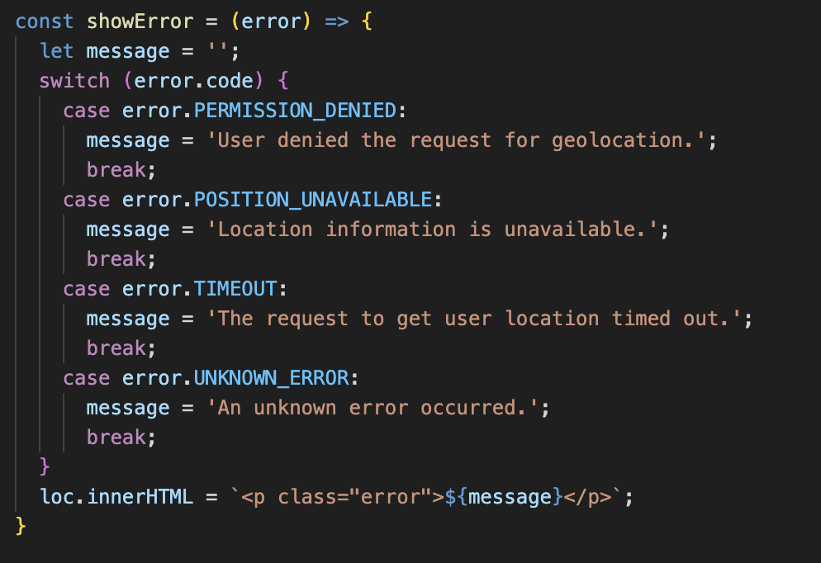
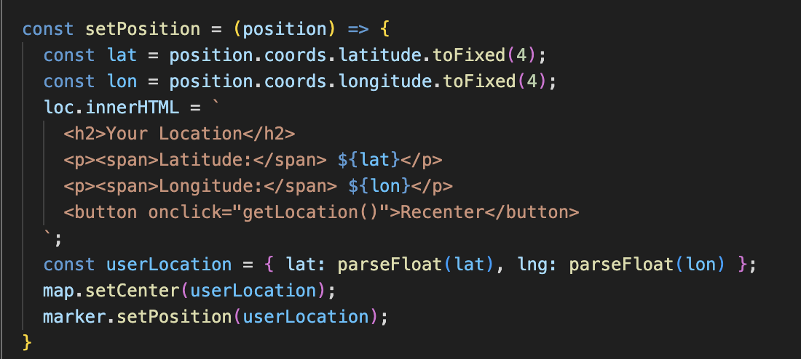
Get geolocation

Slide 7
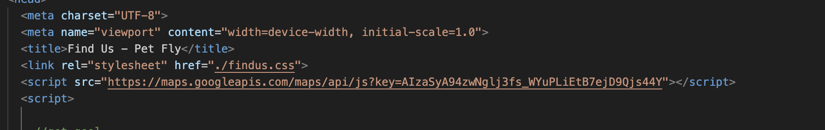
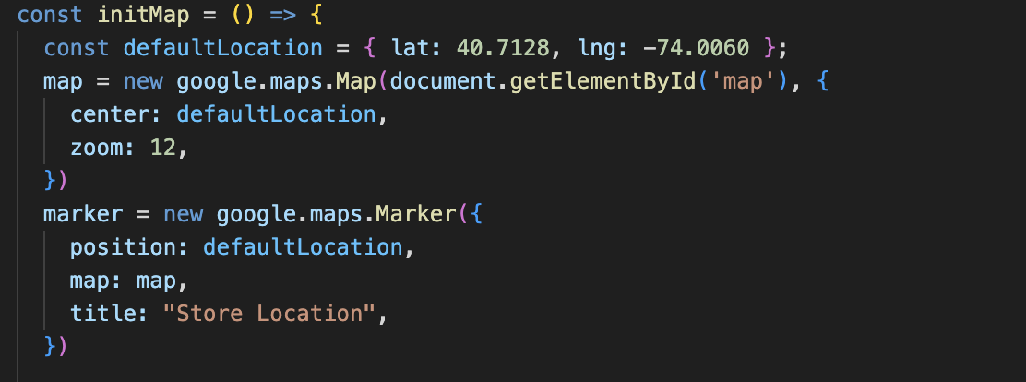
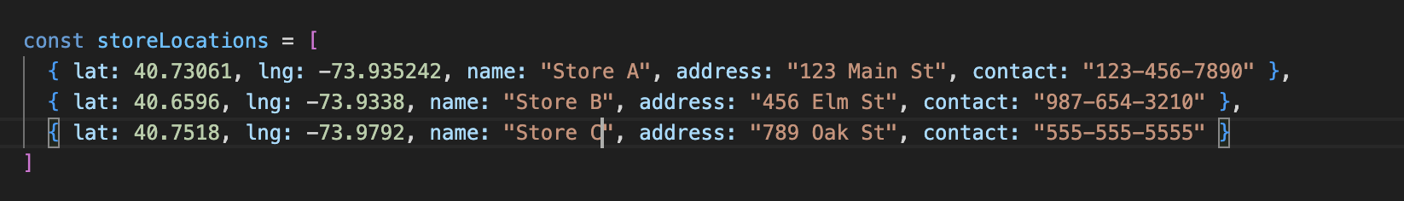
Insert store locators
Notes:
and I searched my API key from google cloud platform
defaultLocation: The map is initially centered on New York City (latitude: 40.7128, longitude: -74.0060).
google.maps.Map: Creates a new map in the HTML and center: Sets the center of the map to defaultLocation. zoom: Sets the zoom level of the map to 12 (city-level zoom).
google.maps.Marker: Adds a marker to the map at the default location.
And I just randomly choose some latitude and longitude, and add markers for each store and display them in the map.

Slide 8
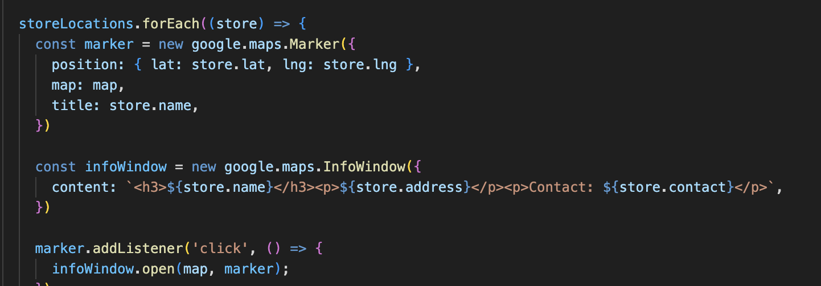
Insert store location

Slide 9
Things I added:
Navigation bar/buttons
Add geolocation
Typing effect
Store locator
Carousel
Gsap
Add hover effects

Slide 10
Thank You!!!
Name
Department Course Number Section Time Location
DATE

